Slide 1
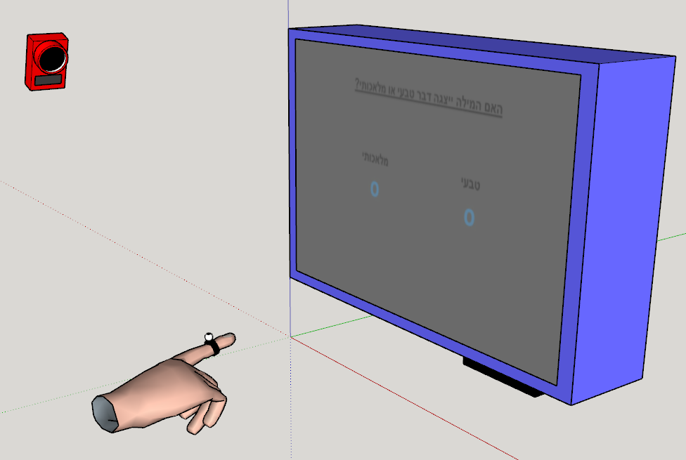
Congruent
Screen
Screen
Incongruent
Trial 1
Z index
Trial 3
Trial 2
Z index
Trial 4
Z index
Time3
same
diff
Time2
Time1
X pos
X pos
X pos

